Slide 1

Year 11 information evening

Slide 2
What do we want for our children in the future?
Healthy life, happy, successful etc
I want you to pause for a moment and think about this.
This presentation is about the students learning journey. This coming year and what we the school, parents/carers and students can do to find the best way through.
It will be hard at times
It may be a challenge.
Its inevitable that your child will make mistakes but more important that they learn from them.
As you will see your child is near the end of their OGS journey and this next year is very likely going to shape their future. I am sure you will agree we all want this to a happy, healthy fulfilled future where doors are always open to them rather than being shut with missed opportunities.

Slide 3


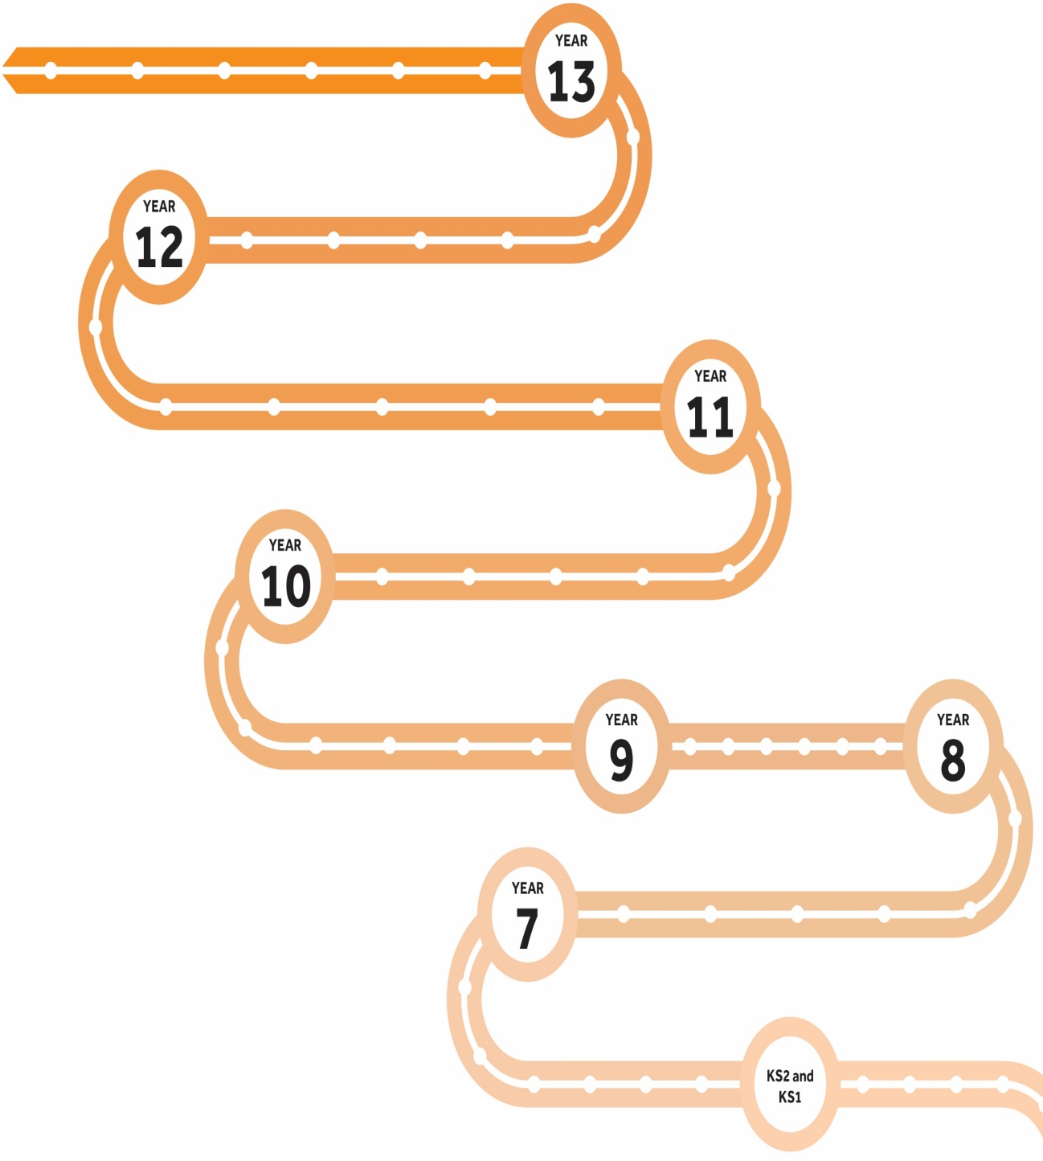







A Levels
Term 3
Term 2
Term 1
Futures
Organisation
Resilience
Initiative
Communication
Term 1
Term 2
Term 3
Starting GCSEs
Term 3
GCSE Exams
Term 2
Final Exams
Term 1
Mock Exams
KS4-5 Next steps
GCSEs
Wellbeing
New learning
Year 10 Exams
Year 11 mocks
Term 1
GCSE courses
Term 2
Parents evening
Term 3
Exams
Healthy body and mind
PPEs
Term 2
Term 2
Term 3
Term 1
KS3-4 Transition
Term 3
Term 1
LEARNING JOURNEY
Term 1
Starting out
Term 2
Term 3
KS2-3 Transition
SATs

Slide 4
Key Stage 4
End-of-course GCSE exams
All exams are now taken at the end of the course
Spelling, punctuation and grammar are assessed.
Students who do NOT achieve a grade 4 in both or either English and Maths at the end of year 11 will have to resit the examination until the grade 4 is achieved or up to the age of 18, whichever is sooner
BTECs and other vocational courses
At least 20% is externally assessed.

Slide 5
You may have experience of GCSE examinations with older children or yourself, however, there have been significant changes to GCSE and BTEC qualifications over the last few years.
These changes have seen a return to exams taken at the end of the course, and measures to improve the assessment of spelling, punctuation and grammar with specific questions being award SPAG marks.
Students who do not achieve English Language and Maths at a level 4 in Year 11 when they get their GCSE results will be required to resit these up until the age of 18 until they do. This is a national requirement for all colleges and sixth forms.

Slide 6
All university courses in the UK require level 4 in these two subjects and will not offer places to students who do not fulfil this. Therefore you will see us focussing a little more on English and maths grades than others this year.
Many of our Year 11 students are taking BTECs and other vocational courses such as construction, business, IT and Health and Social Care.
At least 20% of these qualifications will be externally assessed , rather than being 100% coursework based.

Slide 7

GCSE grading
All GCSEs are now graded 9 - 1 (a number and not a letter).

Slide 8
Non examined element
NEA is the name given now to work completed in school under controlled conditions within a set time limit
Good ATTENDANCE is essential. All students will be informed when NEAs are taking place by their class teacher.
The criteria for each subjects NEA differs.
Subjects that have NEAs are: DT, PE, Drama, Music, Food Technology, Art, English language – speaking component, Languages – speaking component, all Btec internal assessments

Slide 9
What will we be doing at school with data?
Two grade gathers a year – December and April
Two rounds of Mocks –November and March
Current grades
Target grades
Teacher Predictions
Effort
Homework
Behaviour
Tracking of Data by HODS, Mr Bowles and SLT

Slide 10

Help them set goals from the outset
Encourage them to set goals
Help focus them and talk to them about their goals regularly
Give positive reinforcement
Connect with them about ‘why’ and ‘what’ they want to achieve

Slide 11
How can you assist at home?
Five 9-4 grades are essential for most 6th forms and colleges.
Top universities increasingly look at GCSE grades when offering places
It’s essential students develop good study skills from the outset
Assist students complete their homework.
Help students to get their files and books organised
Ensure that everyone in the family knows the importance of external examinations and that study rooms are free from disturbance
Equipping: provide pens, paper, cards highlighters, folders, etc
Offer support and advice

Slide 12
Attendance:
Every school day counts
We expect all students (year 7 to 13) to aim for 100% attendance and punctuality.
Research shows there is a strong correlation between good attendance and exam success.
Obviously if you are not in school you are not going to learn. Every missed lesson needs to be caught up.
Government targets state that students should have 96% attendance or above.

Slide 13
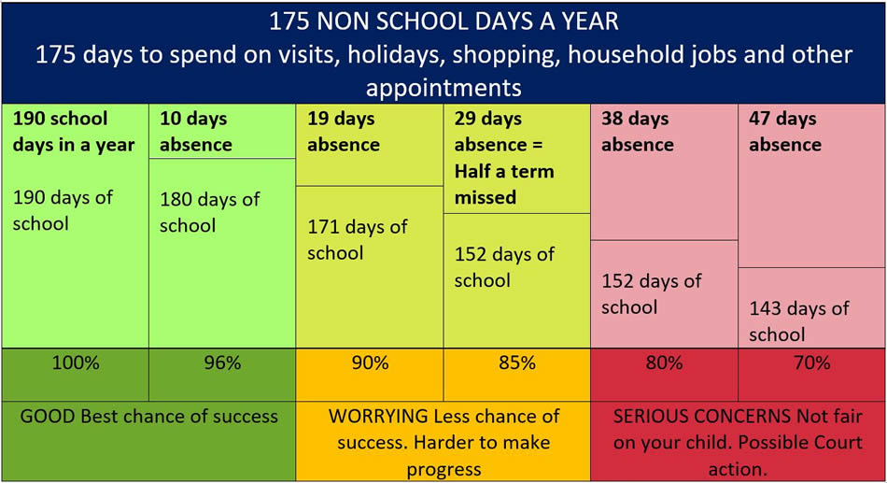

Slide 14
This next slide is quite powerful.
We are in school 39 weeks out of a 52 week year.
Including weekends and school holidays this leaves 175 days per year for students to go on holiday, go shopping, visit the dentist, hairdressers etc – on the whole these aren’t acceptable reasons to miss a day of school.
Ten days off a whole academic year will give a student 96% attendance any more than 10 days off starts to impact on attainment.

Slide 15
If a Student has 90% attendance, what it actually means is…
90% attendance = ½ day missed every week!!
1 school year at 90% attendance = 4 whole weeks of lessons MISSED!!!
90% attendance for 5 years of secondary school…. = ½ a school year missed!
90% attendance may sound good but it isn’t. If you were employed, half a day off every week would more than likely lose you your job. Look at the impact of poor attendance over five years….

Slide 16

What impact might this have on a student’s life……?
Research suggests that 17 missed school days a year = GCSE grade DROP in achievement. (DfES)
The greater the attendance the greater the achievement.

Slide 17
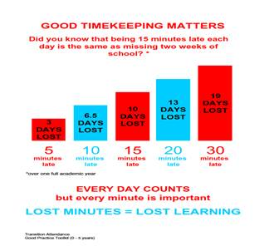

Slide 18

Sometimes students may feel like they are climbing a mountain
Its essential for our students to be mentally and physically fit.
To be both smart and healthy.
The goal of getting great results at the end of year 11 can seem unreachable and unattainable for many of your students and this can have a huge affect on mental health.

Slide 19

Top tips

Slide 20
Students have a team of experts to support them in the school to help them on their path to success.
The school has also invested thousands in resources to help them for example GCSE pod, speakers that come in to talk about study skills , we are also part of NTP which using government money to bridge the gap in learning as a result of home schooling during covid.

Slide 21

How can you help your child
and prepare them for the exams?
Study skills
Keep them active
Healthy eating
Time out
Sleep patterns
Unplugging
Staying cool & calm
Belief
Be supportive

Slide 22

Unplugging
Encourage them to unplug from technology everyday
Help them switch off from technology at least 30 mins- 1 hr before going to sleep
Support your child to appreciate the world around them rather than being governed by their phone
Make sure they put their phone away, & on silent, while they are concentrating on tasks / revision / homework
Help them learn to have the control to not be obsessed with their phone
Choose some time each day/week to switch off and unplug from technology with them

Slide 23


Managing stress
Managing stress
SUPPORT AVAILABLE IN SCHOOL
Tutor, Head of Year and Deputy Headteacher (Pastoral), Well-being Champions.
SUPPORT AVAILABLE OUTSIDE OF SCHOOL
Skyline Support services are free online services brought to you by Off the Record, providing online counselling and workshops to young people aged 14-25 in Croydon and Sutton. You can find out more about their services at www.skylinesupport.org
OR
Download the Calm Harm app

Slide 25
How can you assist at home?
Study skills and Revision
As they complete each topic students should be compiling revision materials and learning key facts.
Organise periods of time for learning facts and revision well in advance of tests and exams
Including the most appropriate revision periods during the day, when distractions are least likely
Reduce distractions (e.g. TV, radio, and switch off mobile phones)
Offer to test material
Use of revision websites and apps,
e.g. BBC Bitesize, MyMaths, exam board websites (past papers)

Slide 26
https://www.youtube.com/watch?v=Fc9wPYlnCgU

Slide 27

Careers guidance
The Careers Manager. Mrs Oakley, is based in the LRC

Slide 28


Slide 29
Unifrog - The universal destinations platform - YouTube

Slide 30

What is Unifrog?
Unifrog is a one-stop-shop where students can easily explore their interests, then find and successfully apply for their next best step after school.
Unifrog will help you to explore your key interests and what career paths you can take to reach your goals!
Notes:
I am really excited to be talking to you about Unifrog today. This is a new piece of software we have brought into for you all. In essence Unifrog is your one stop shop to learn about careers and make informed choices about you futures.
Tomorrow Unifrog will go live to years 7 and 8 – you will receive an email via your school accounts from Unifrog. Your tutors have been given your school email address and pass words – please see them for this information. You will need this to access your school email account. Please remember this is a professional / work account and should be used as such. Your emails can and will be monitored if used inappropriately.

Slide 31
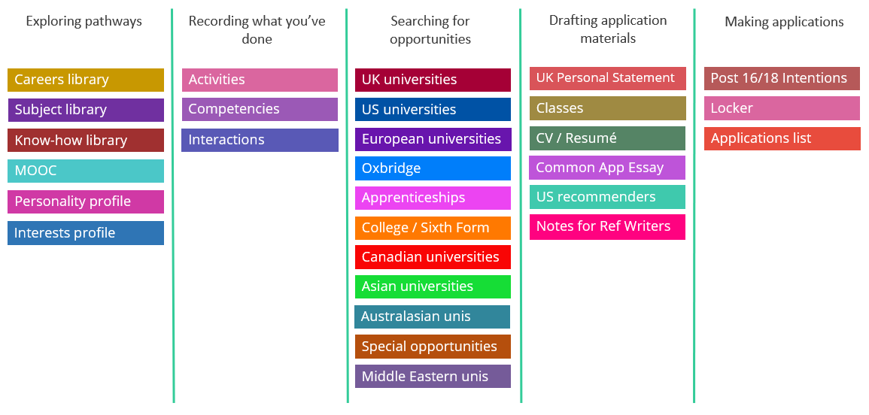
Available resources

Slide 32
Post 16 Help
Talks from South Thames and Nescot on apprenticeships/ Level 3 qualifications.
Mr O’Neill ( Head of Sixth Form) will speak to all the students about OG6.
Application for colleges and sixth forms need to be submitted by Christmas
Careers leaders run drop in sessions for any students that need help applying.

Slide 33
Important Dates
November 2023 | Mock 1 Exams
December 2023 | Results afternoon Grade Gather 1/ Tutor Reports sent home
February 2024 (Thursday 8th | Virtual Parents evening
March 2024 | Mock 2 Exams
Apirl 2024 | Grade gather 2 data sent home
May 2024 | GCSE Exams start 9th May (3 weeks after Easter Holidays)

Slide 34
Points of Contact
Pastoral Support | Academic Support
Tutors | Class teachers
Head of Year Mr Bowles | Head of Department
Assistant Head of Year Mr Page
Attendance Officer Mrs Stringer
Family Support Officer Pep Nicol

