Slide 1

Year 10 information evening

Slide 2


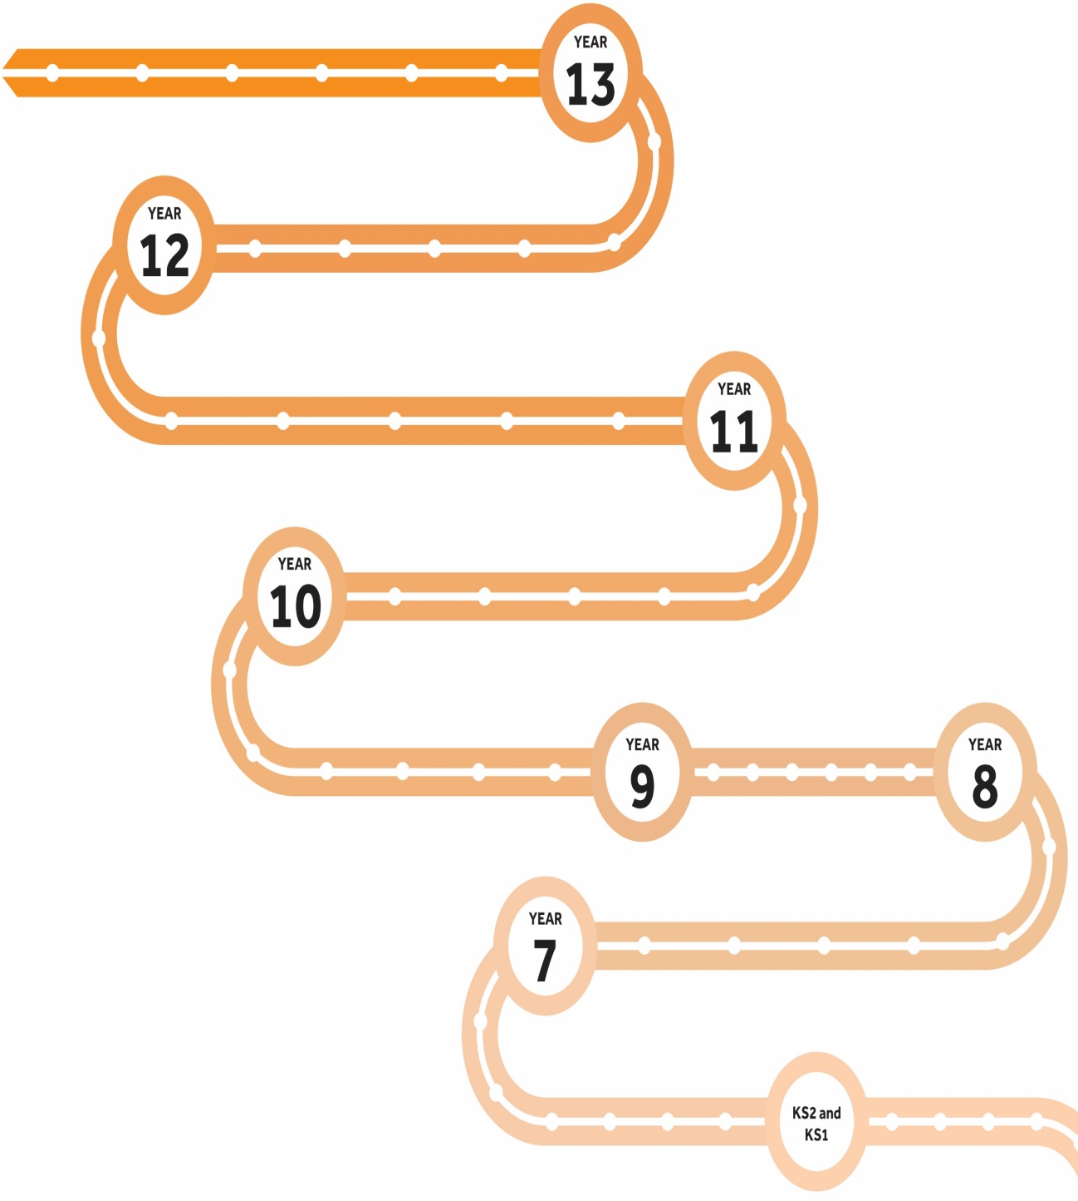







A Levels
Term 3
Term 2
Term 1
Futures
Organisation
Resilience
Initiative
Communication
Term 1
Term 2
Term 3
Starting GCSEs
Term 3
GCSE Exams
Term 2
Final Exams
Term 1
Mock Exams
KS4-5 Next steps
GCSEs
Wellbeing
New learning
Year 10 Exams
Year 11 mocks
Term 1
GCSE courses
Term 2
Parents evening
Term 3
Exams
Healthy body and mind
PPEs
Term 2
Term 2
Term 3
Term 1
KS3-4 Transition
Term 3
Term 1
LEARNING JOURNEY
Term 1
Starting out
Term 2
Term 3
KS2-3 Transition
SATs

Slide 3
Key Stage 4
End-of-course GCSE exams
All exams are now taken at the end of the course
Spelling, punctuation and grammar are assessed.
Students who do NOT achieve a grade 4 in both or either English and Maths at the end of year 11 will have to resit the examination until the grade 4 is achieved or up to the age of 18, whichever is sooner
BTECs and other vocational courses
At least 20% is externally assessed.
Notes:
Students who do not achieve English Language and Maths at a level 4 in Year 11 when they get their GCSE results will be required to resit these up until the age of 18 until they do. This is a national requirement for all colleges and sixth forms.
All university courses in the UK require level 4 in these two subjects and will not offer places to students who do not fulfil this. Therefore you will see us focussing a little more on English and maths levels in the next two years.
Some of our Year 10 students have also started their BTECs and other vocational courses such as construction, business, IT and Health and Social Care.
At least 20% of these qualifications will be externally assessed , rather than being 100% coursework based.

Slide 4

GCSE grading
All GCSEs are now graded 9 - 1 (a number and not a letter).
Notes:
So in August 2025 your child will receive levels not grades. A level 1 is the lowest and a 9 the highest. You can see the old gcse grades equivalents here. A level 9 is on a par with an old A*A* grade.

Slide 5
Non examined element
NEA is the name given now to work completed in school under controlled conditions within a set time limit
Good ATTENDANCE is essential.
The criteria for each subjects NEA differs.
DT
Pe
Drama
Music
Food Technology
Art
English language – oral component
Languages – oral component
Btec internal assessments in H and S, Construction, IT
Notes:
NEA is the name given now to work completed in school under controlled conditions within a set time limit
NEA’S feature in several of our KS4 courses.
Under these rules work must be completed in school under teacher supervision, similar to examination conditions, and within a set time limit.
Examples of these could be a food tech’practical’ exam where they need to prepare and cook a meal under timed conditions or our drama students performing a drama piece in the theatre in front of a moderator, language and English oral exams would also fall under this category.
Full attendance for these periods is essential, and total commitment is needed.
All students will be informed when these place by their class teachers.

Slide 6
What will we be doing at school with data?
Two grade gathers a year – March and July
End of Year 10 exams – June
Current grades
Target grades
Teacher Predictions
Effort
Homework
Behaviour
Tracking of Data by HODS, Mr Spriggs and SLT
Notes:
At KS4 We track data throughout the year and it will be acted on.
We do two grade gathers throughout the year across the school. We collect effort and current grades as well as predictions from subject teachers
A report will also be issued during the year, for year 10 this will be in the spring term
We use target grades based midysis tests. These are realistic and achievable. Students will know their target predictions for each subject and they should be working towards them.
Teacher predictions are collected to compare with Target grades and are used to identify appropriate interventions for identified groups of students

Slide 7

Help them set goals from the outset
Encourage them to set goals
Help focus them and talk to them about their goals regularly
Give positive reinforcement
Connect with them about ‘why’ and ‘what’ they want to achieve
Notes:
Although its early days students need to set goals for the future now.
These 2 years are very important for their future success, whatever path they choose to follow.
Students need to aim for success to achieve the future life they want
There is a passport to success into the next stage and this is 5,9-4 grades including English and Maths at grade 4 or above and almost all colleges, schools and employers will require this
The partnership we continue to develop between home, school and students is of the utmost importance to ensure they reach their full potential.
It is very easy for students to think at this stage of the year that the final exams are a long way off and that they have plenty of time, but in reality it is not very long and there is a lot of work to do before then. Exam start before the summer half term in Year 11 and with most subjects having finished the course by Easter – this really makes KS4 five terms of learning and not 6!

Slide 8
How can you assist at home?
Five 9-4 grades are essential for most 6th forms and colleges.
Top universities increasingly look at GCSE grades when offering places
It’s essential students develop good study skills from the outset
Assist students complete their homework.
Help students to get their files and books organised
Ensure that everyone in the family knows the importance of external examinations and that study rooms are free from disturbance
Equipping: provide pens, paper, cards highlighters, folders, etc
Offer support and advice
Notes:
Its well known that the top universities like Oxford and Cambridge look at GSCE results and expect to see levels 8 and 9 across the board in all GCSE’S.
Russell group universities also will be looking at high levels particularly in maths and English when they offer places.
Its imperative that our students develop and sustain good study skills from the get go and you as their parents and carers can help facilitate this.
On the slide are just a selection of ways in which you can help your child.

Slide 9
Attendance:
Every school day counts
We expect all students (year 7 to 13) to aim for 100% attendance and punctuality.
Research shows there is a strong correlation between good attendance and exam success.
Notes:
Obviously if you are not in school you are not going to learn. Every missed lesson needs to be caught up. Government targets state that students should have 96% attendance or above.

Slide 10
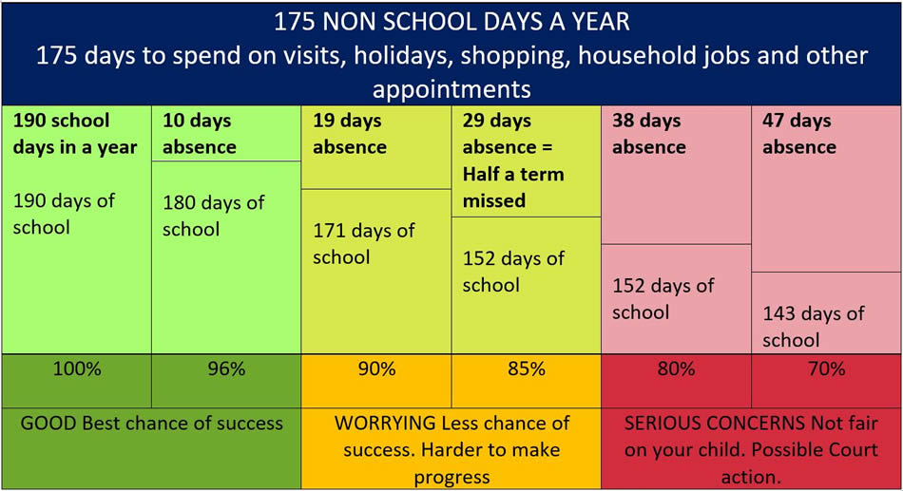
Notes:
This next slide is quite powerful. We are in school 39 weeks out of a 52 week year. Including weekends and school holidays this leaves 175 days per year for students to go on holiday, go shopping, visit the dentist, hairdressers etc – on the whole these aren’t acceptable reasons to miss a day of school. Ten days off a whole academic year will give a student 96% attendance any more than 10 days off starts to impact on attainment.

Slide 11
If a Student has 90% attendance, what it actually means is…
90% attendance = ½ day missed every week!!
1 school year at 90% attendance = 4 whole weeks of lessons MISSED!!!
90% attendance for 5 years of secondary school…. = ½ a school year missed!
Notes:
90% attendance may sound good but it isn’t. If you were employed, half a day off every week would more than likely lose you your job. Look at the impact of poor attendance over five years….

Slide 12

What impact might this have on a student’s life……?
Research suggests that 17 missed school days a year = GCSE grade DROP in achievement. (DfES)
The greater the attendance the greater the achievement.

Slide 13
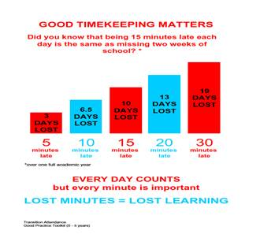

Slide 14

Sometimes students may feel like they are climbing a mountain
Notes:
Its essential for our students to be mentally and physically fit.
To be both smart and healthy.
The goal of getting great results at the end of year 11 can seem unreachable and unattainable for many of your students and this can have a huge affect on mental health.

Slide 15

Top tips
Notes:
Students have a team of experts to support them in the school to help them on their path to success.
The school has also invested thousands in resources to help them for example GCSE pod, speakers that come in to talk about study skills , we are also part of NTP which using government money to bridge the gap in learning as a result of home schooling during covid.

Slide 16

How can you help your child
and prepare them for the exams?
Study skills
Keep them active
Healthy eating
Time out
Sleep patterns
Unplugging
Staying cool & calm
Belief
Be supportive
Notes:
Its really important that as parents and carers you give your support, some suggestive points are on the slide.
Contrary to what your child may tell you many parents take mobiles from their children at a set time every night to prevent them scrolling and messaging all the time. This is good parenting and there is numerous evidence based research that this supports mental well being.

Slide 17

Unplugging
Encourage them to unplug from technology everyday
Help them switch off from technology at least 30 mins- 1 hr before going to sleep
Support your child to appreciate the world around them rather than being governed by their phone
Make sure they put their phone away, & on silent, while they are concentrating on tasks / revision / homework
Help them learn to have the control to not be obsessed with their phone
Choose some time each day/week to switch off and unplug from technology with them
Notes:
We are seeing more and more students becoming addicted to their phones and the fear of not always being connected and missing out.
If your child would rather be on their phone rather than have a face to face conversation try and encourage them to put it down.
What is their reactions when they lose their phone? Is that a healthy response?

Slide 18


Managing stress
Managing stress
SUPPORT AVAILABLE IN SCHOOL
Tutor, Head of Year and Deputy Headteacher (Pastoral), Well-being Champions.
SUPPORT AVAILABLE OUTSIDE OF SCHOOL
Skyline Support services are free online services brought to you by Off the Record, providing online counselling and workshops to young people aged 14-25 in Croydon and Sutton. You can find out more about their services at www.skylinesupport.org
OR
Download the Calm Harm app
Notes:
There is a leaflet on our website about recognising stress and managing stress.

Slide 19

https://www.youtube.com/watch?v=Fc9wPYlnCgU
Notes:
Every student at Overton is subscribed to GCSE pod – this is an online learning platform with …..

Slide 20

Careers guidance
The Careers Manager is based in the LRC
Notes:
Our careers advisors Ms Oakley is based in the library. Every year 10 student will have a career interview which is minuted and actioned.

Slide 21


Slide 22
Unifrog - The universal destinations platform - YouTube

Slide 23

What is Unifrog?
Unifrog is a one-stop-shop where students can easily explore their interests, then find and successfully apply for their next best step after school.
Unifrog will help you to explore your key interests and what career paths you can take to reach your goals!
Notes:
I am really excited to be talking to you about Unifrog today. This is a new piece of software we have brought into for you all. In essence Unifrog is your one stop shop to learn about careers and make informed choices about you futures.
Tomorrow Unifrog will go live to years 7 and 8 – you will receive an email via your school accounts from Unifrog. Your tutors have been given your school email address and pass words – please see them for this information. You will need this to access your school email account. Please remember this is a professional / work account and should be used as such. Your emails can and will be monitored if used inappropriately.

Slide 24
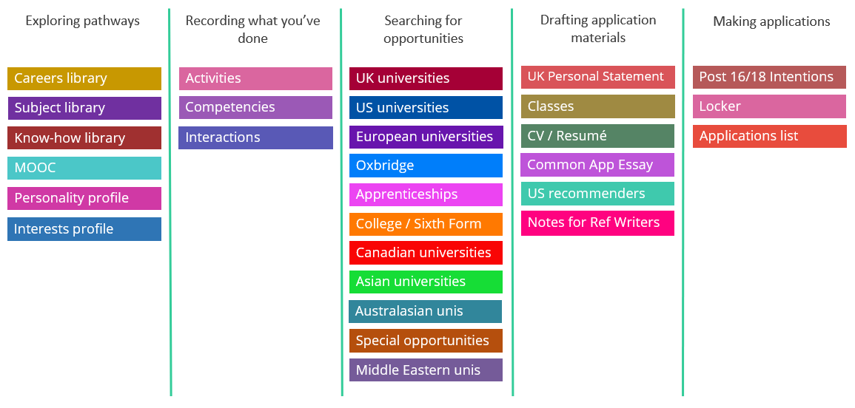
Available resources

Slide 25
Post 16 Help - all coming up in KS4
All students need to aim for 5 GCSE’s grade 4 and above to get into most sixth forms / colleges
With at least a grade 6 if they wish to study the subject at A Level.
Talks from South Thames and Nescot on apprenticeships/ Level 3 qualifications.
Mr O’Neill ( Head of Sixth Form) will speak to all the students about OG6.
Application for colleges and sixth forms need to be submitted by Christmas 2025
Careers leaders run drop in sessions for any students that need help applying.

Slide 26
Important Dates
October 2023 | Parent / Tutor evening face to face in school Appointments will be made via school cloud.
March 2023 | Grade Gather 1/ Tutor Reports sent home
April 2024 | Parents evening – logistics yet to be confirmed.
June 2024 | Year 10 Exams
July 2024 | Grade gather 2 data sent home

Slide 27
Points of Contact
Pastoral Support | Academic Support
Tutors | Class teachers
Head of Year Mr Spriggs | Head of Department
Assistant Head of Year Ms Hodgson
Attendance Officer Mrs Stringer
Family Support Officer Pep Nicol
Notes:
On this slide are the numerous staff that are here at Overton to support your child. If in any doubt please contact your child's tutor or HOY in the first instance.
And that concludes todays presentation – I am happy to take any questions or feel free to email me or Mr Bowles for any advice.
Any questions?
With that I will say goodbye and thankyou once more for joining me this evening.
Please exit the meeting, a copy of the ppt will be made available on the school website.

